Slide 1
Tools and Technologies: Final Project

Slide 2
Agenda
Favorite Tool
Least Favorite Tool
Demonstration:
Microsoft Word to MadCap Flare Software

Slide 3

MadCap Flare
Advantages:
Regulatory Compliance and Traceability
Content Reuse (single sourcing)
Drawbacks:
Steep Learning Curve
High Cost and Licensing
Type of Projects to use MadCap Flare:
In pharmaceutical industry – complex, highly regulated documentation

Slide 4
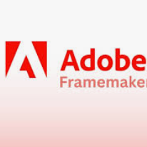
Adobe Framemaker
Why dislike this tool?
Not user-friendly for beginners
The software feels antiquated
Why still use it? What are the advantages?
Handling Long, Complex Documents
Structured XML/DITA Authoring
What would you instead (and why)?
MadCap Flare
User Interface
Formatting Features

Slide 5
Thank you, Zoe!
The last fifteen weeks of class for me proved to be a period filled with both challenges and rewards.
I found your knowledge and the experiences you shared to be truly valuable and enriching for my learning.

